Slide 1

CAP 6317/4773: Social Media Mining
Lecture 1: The “Social” and the “Media”
Raiyan Abdul Baten, Ph.D.
January 9, 2024
Notes:
This is a story about ideas. To set the stage, I’ll start with this question

Slide 2
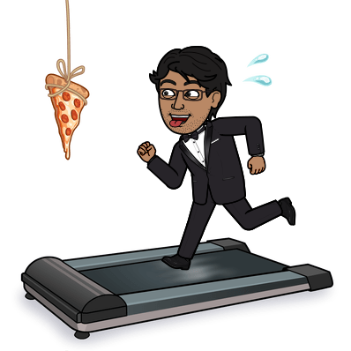
I’m Dr. Raiyan Abdul Baten
My research is on soft skills and social networks
I enjoy graphic design, photography, baking, and distance running

Slide 3
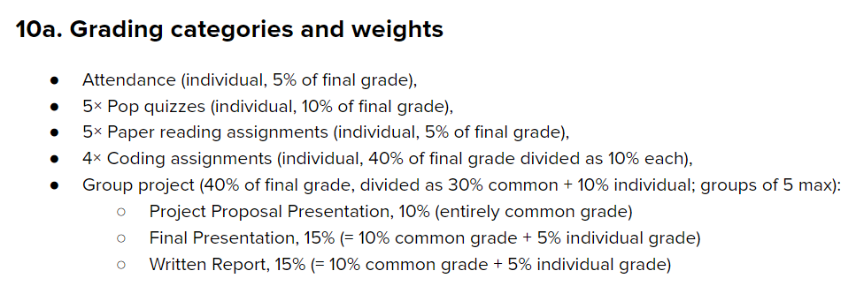

Slide 4
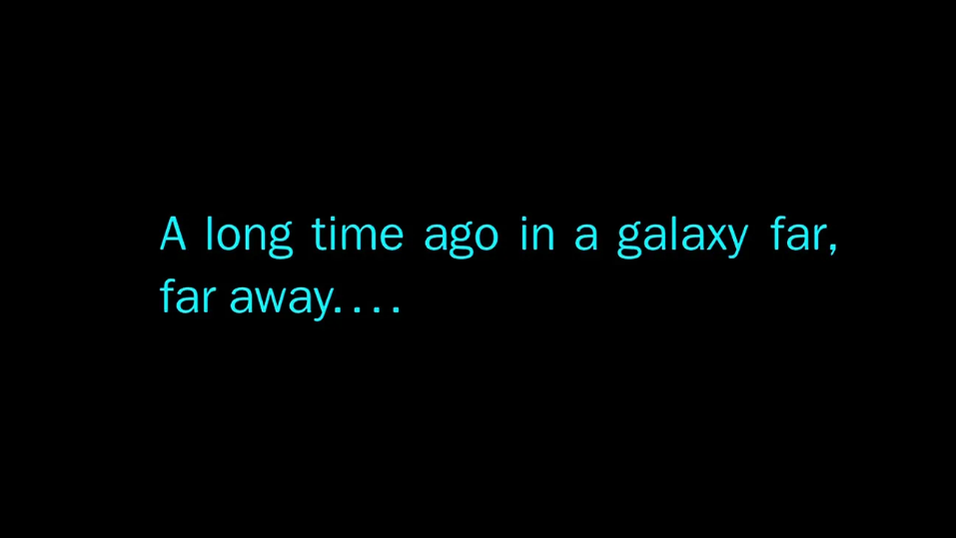

Slide 5
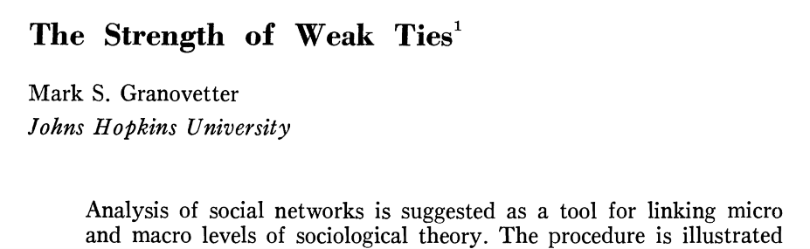

Slide 6
How do you test the idea?

Slide 7

How do you test the idea?
Traditional approach: Ask around!
: Hey, how did you learn about this job?
: Bob told me.
: Would you say Bob is a close friend or an acquaintance?
: I’d say acquaintance.

Slide 8

Now we have LinkedIn!

Slide 9

Now we have LinkedIn!

Slide 10

Now we have LinkedIn!
4 mutual friends
Tie strength can be measured!

Slide 11
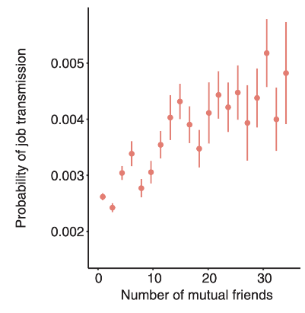
Now we have LinkedIn!
4 mutual friends

Slide 12
Now we have LinkedIn!
4 mutual friends
Strong ties appear to work better!

Slide 13
Not so fast…
My ‘weak tie’ friend works at Google
I join Google

Slide 14
Not so fast…
I form a tie with a Google engineer
I WANT TO JOIN Google

Slide 15
Not so fast…
Job market situation changes
My ‘weak tie’ friend works at Google
I join Google

Slide 16
Not so fast…
Job market situation changes
My ‘weak tie’ friend works at Google
I join Google
LinkedIn kept recommending us Google opportunities

Slide 17
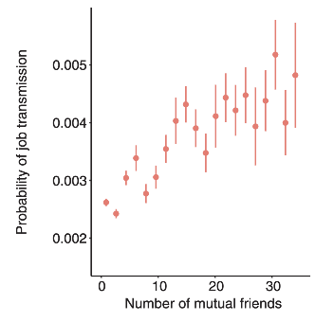
Not so fast… Confounding effects are real
Job market situation changes
?
My ‘weak tie’ friend works at Google
I join Google
LinkedIn kept recommending me Google opportunities

Slide 18
A causal claim demands fancy data wizardry
Job market situation changes
Peer recommendation engine updates
My ‘weak tie’ friend works at Google
I join Google
LinkedIn kept recommending me Google opportunities

Slide 19
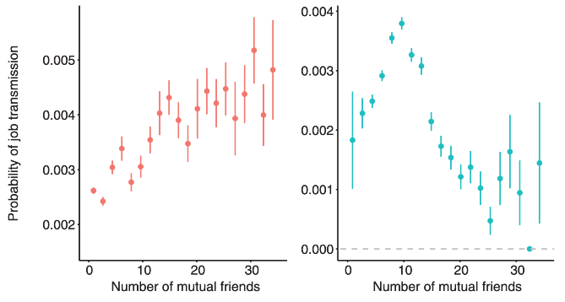
OLS
IV Regression
Rajkumar, Karthik, et al. "A causal test of the strength of weak ties." Science 377.6612 (2022): 1304-1310.

Slide 20
OLS
IV Regression
The strength of weak ties!
Rajkumar, Karthik, et al. "A causal test of the strength of weak ties." Science 377.6612 (2022): 1304-1310.

Slide 21
Takeaways
Two aspects of social media data:
Social: Who people interact with
Media: What they do
Large datasets can help test hypotheses never testable before!
Hypotheses are guided by social and computational theories
The appropriate tools must be chosen to get meaningful results

Slide 22
Drowning in data, but thirsty for knowledge

Slide 23
















Behavioral data is now abundant

Slide 24
We are interested in ‘social’ + ‘media’ data

Slide 25
We are interested in ‘social’ + ‘media’ data
Teams interact virtually

Slide 26
We are interested in ‘social’ + ‘media’ data
Information exchanged via contacts
Teams interact virtually

Slide 27
We are interested in ‘social’ + ‘media’ data
Information exchanged via contacts
Teams interact virtually
Editors interact to curate content

Slide 28
We are interested in ‘social’ + ‘media’ data
Information exchanged via contacts
Teams interact virtually
Editors interact to curate content
Collaborate on a project, ‘star’ others’ projects

Slide 29
We are interested in ‘social’ + ‘media’ data
Information exchanged via contacts
Teams interact virtually
Editors interact to curate content
Collaborate on a project, ‘star’ others’ projects
Write papers together, cite others’ papers

Slide 30
Social Science
Network/computational Science
Let us not forget
Computer science
Machine learning
Ethnography
Mathematics
Optimization
And more!
Social Media Mining
Statistics and Data Mining

Slide 31
Key
Challenges
Enormous size of data
Yet, not much data at an individual level (Big data paradox)
Extremely noisy
Yet, attempting to remove noise may remove valuable information (Noise removal fallacy)
Unstructured
You need capable representations, data structures, and algorithms

Slide 32
Key
Challenges
Interdisciplinary
Being the ‘Deep Learning Ninja’ in the team isn’t enough
Social and computational theories guide your intuition
Evaluation dilemma
Ground truths are rare and costly
Getting the data in the first place
APIs are becoming restricted

Slide 33
The ‘forest’

Slide 34
Essentials
Graph essentials
Network measures
Network models

Slide 35
Essentials
Graph essentials
Network measures
Network models
Who are the most important people in the network?
How do people befriend others?
How can we find interesting patterns in user-generated content?

Slide 36
Essentials
Communities and Interactions
Graph essentials
Network measures
Network models
Community detection
Information diffusion
Who are the most important people in the network?
How do people befriend others?
How can we find interesting patterns in user-generated content?

Slide 37
Essentials
Communities and Interactions
Graph essentials
Network measures
Network models
Community detection
Information diffusion
Who are the most important people in the network?
How do people befriend others?
How can we find interesting patterns in user-generated content?
How can we identify communities in a social network?
How far can an article be transmitted in a social network?

Slide 38
Essentials
Communities and Interactions
Applications
Graph essentials
Network measures
Network models
Community detection
Information diffusion
Social Influence
Recommendation engines
Behavior analysis
Who are the most important people in the network?
How do people befriend others?
How can we find interesting patterns in user-generated content?
How can we identify communities in a social network?
How far can an article be transmitted in a social network?

Slide 39
Essentials
Communities and Interactions
Applications
Graph essentials
Network measures
Network models
Community detection
Information diffusion
Social Influence
Recommendation engines
Behavior analysis
Who are the most important people in the network?
How do people befriend others?
How can we find interesting patterns in user-generated content?
How can we identify communities in a social network?
How far can an article be transmitted in a social network?
How can we measure the influence of individuals in a social network?
How can we recommend content or friends to individuals online?

Slide 40
Graph Essentials

Slide 41
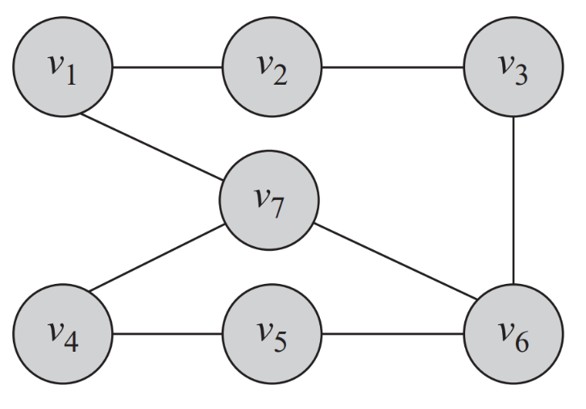

Slide 42
Summary

